Slide 1
Benjamin Renaudin
Comm 201: Digital Imaging
Final Project
Dr. Wilson

Slide 2
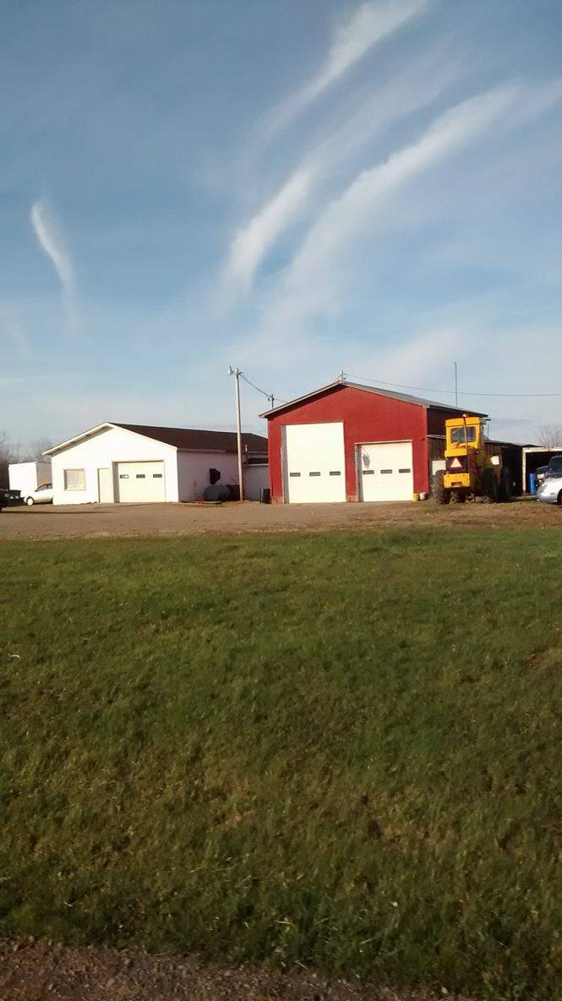
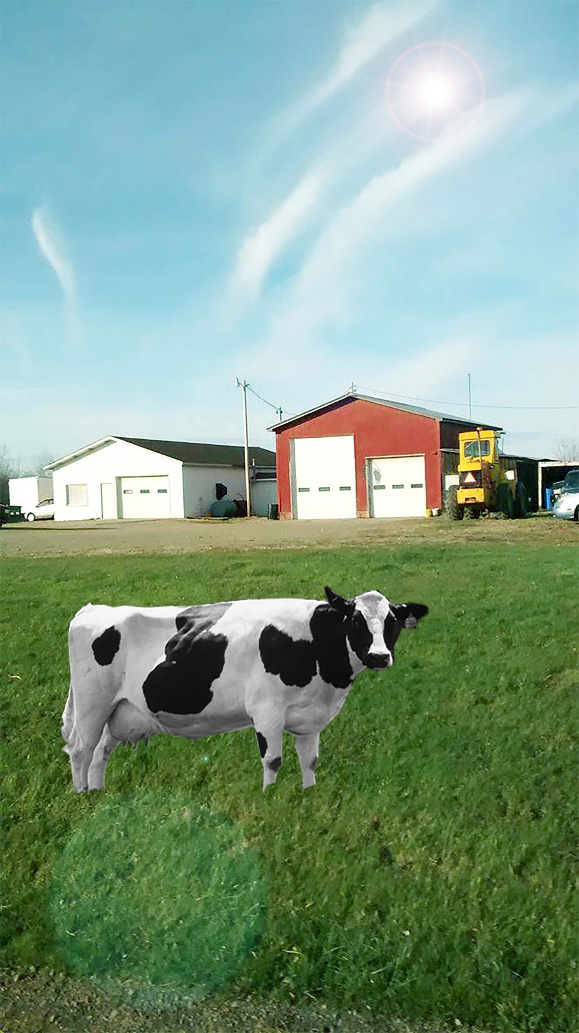
Notes:
In this image, I got a picture of a cow from the internet and used the polygon lasso tool to cut it out. I put it into the other image, and I cleaned up around its edges. I changed the colors to make the ground look a lot brighter and cleaner. I also changed the brightness and contrast. Lastly, I added a lens flare to resemble the sun and to give a reflection near the cow.

Slide 3
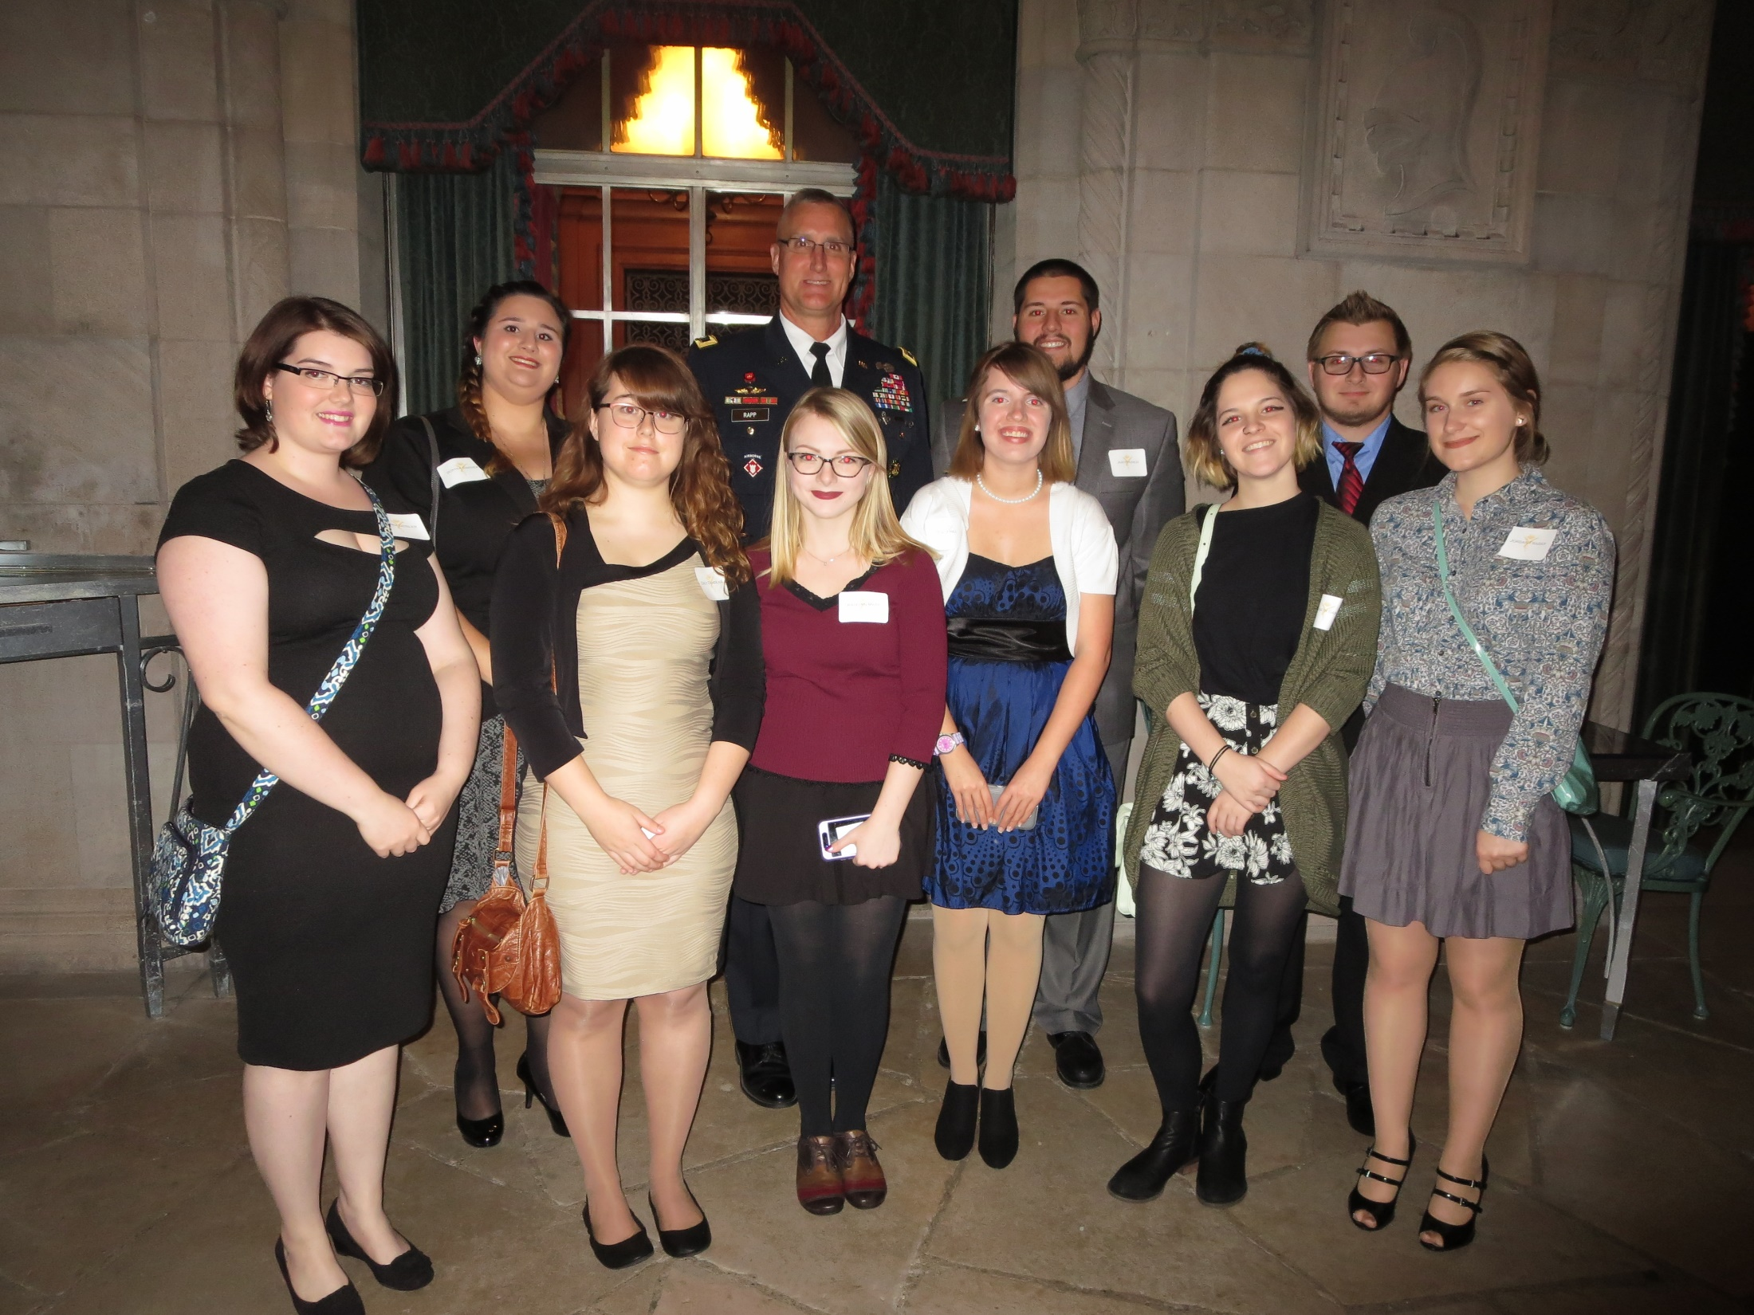
Notes:
In this photo, I took away the red eye from those who had it. I also used the stamp clone tool to get rid of the name tags on everyone. I used the spot healing brush to get rid of blemishes from those who had places that needed cleaned up. Also, I used 3d text to display the name of the event. Lastly, I changed the brightness to make the image look a bit sharper.

Slide 4
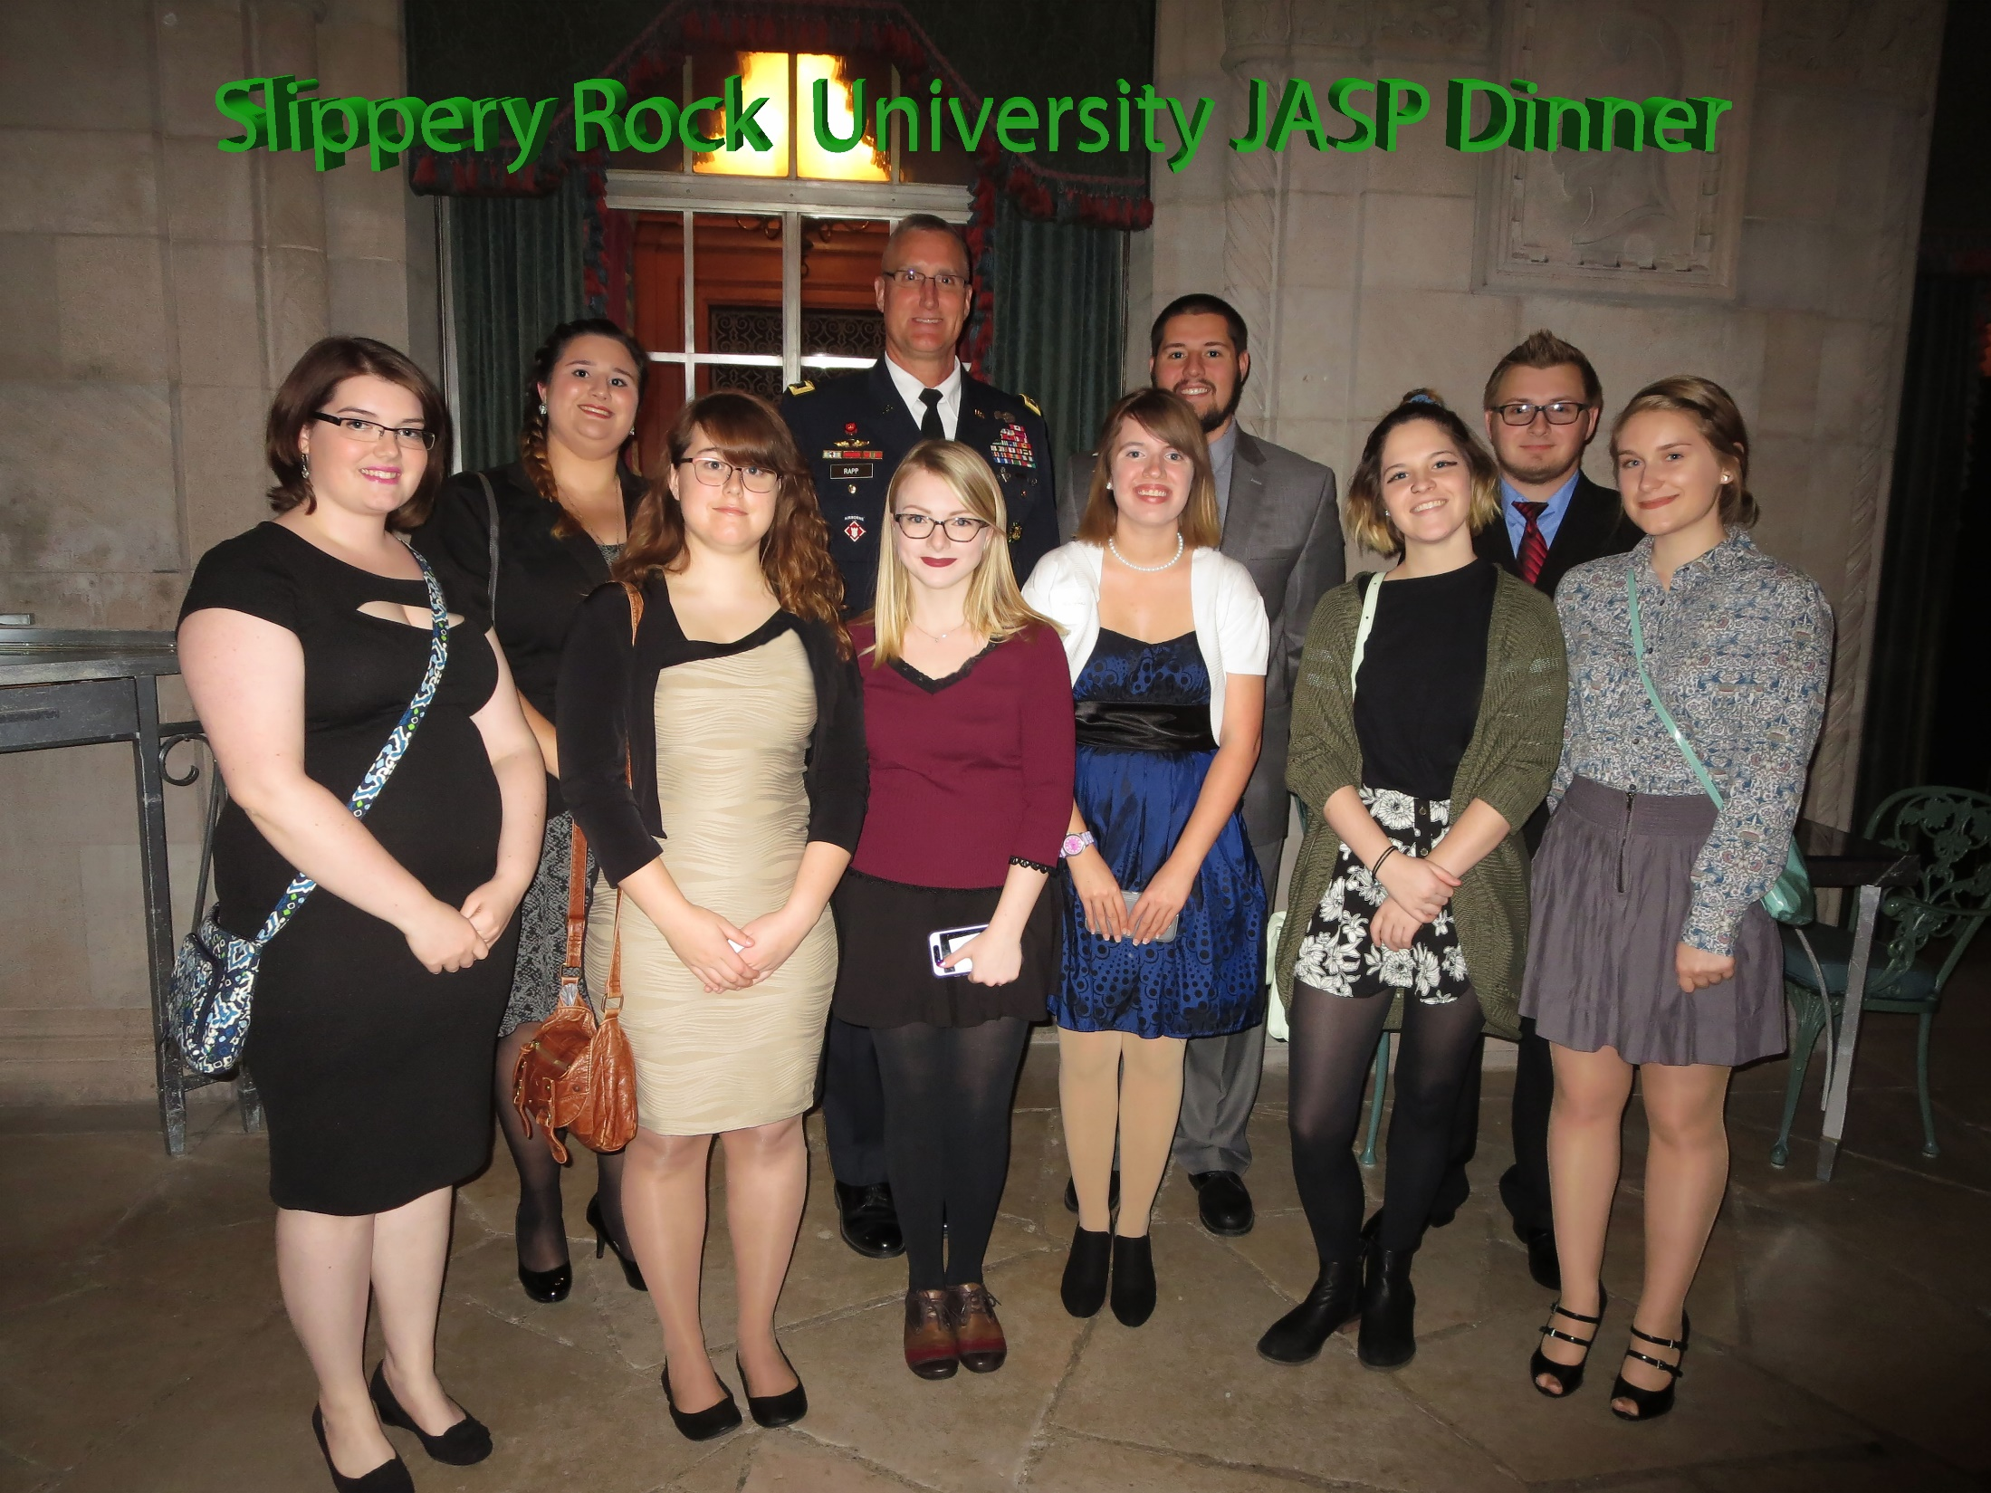

Slide 5
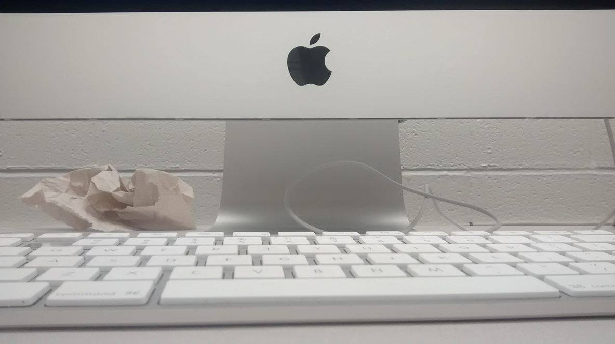
Notes:
I used the stamp clone tool and the spot healing brush to remove the wires and garbage in the background. I also cut out the apple symbol by creating a shape and using the delete key. I used the spot healing brush to get rid of every letter and number on the key. I used magic wand tool to get the actual apple into the picture. Lastly, I adjusted the brightness to give it a sharper effect.

Slide 6
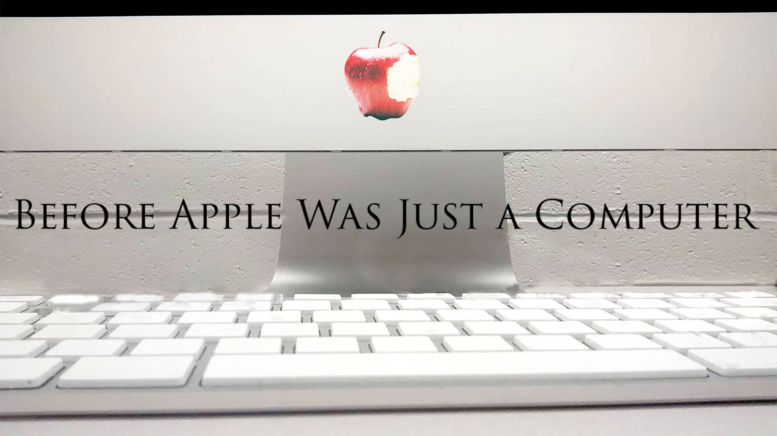

Slide 7
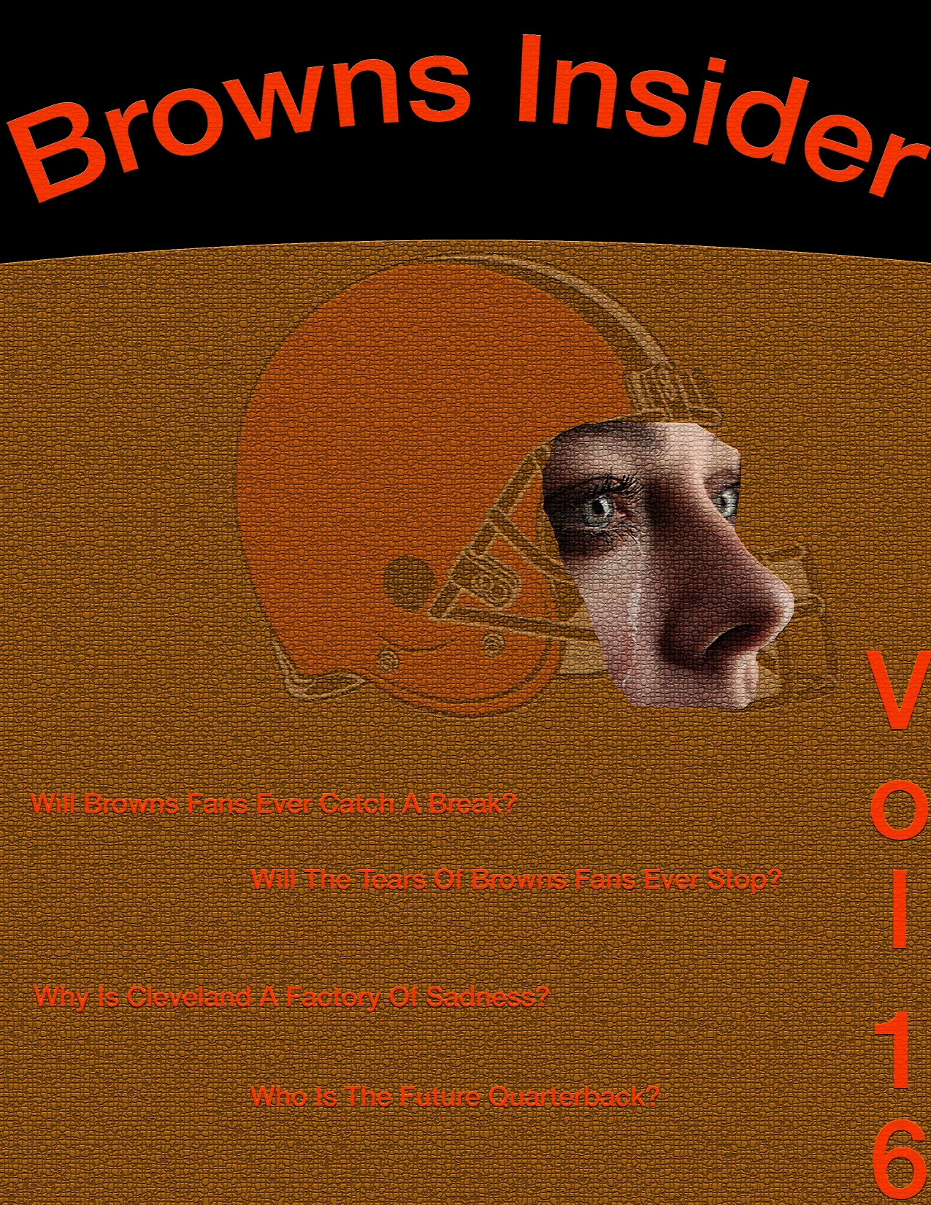
Notes:
On this image, I started from scratch. I cut out an image of a Cleveland Browns helmet using the polygon lasso tool. I did the same thing with the face. The difference that I had with the face was that I cleaned up around the edges using the healing brush. I used a vertical text tool to display what volume the magazine was. I used an artistic filter to display an effect that made the entire magazine look similar to a football.

Slide 8
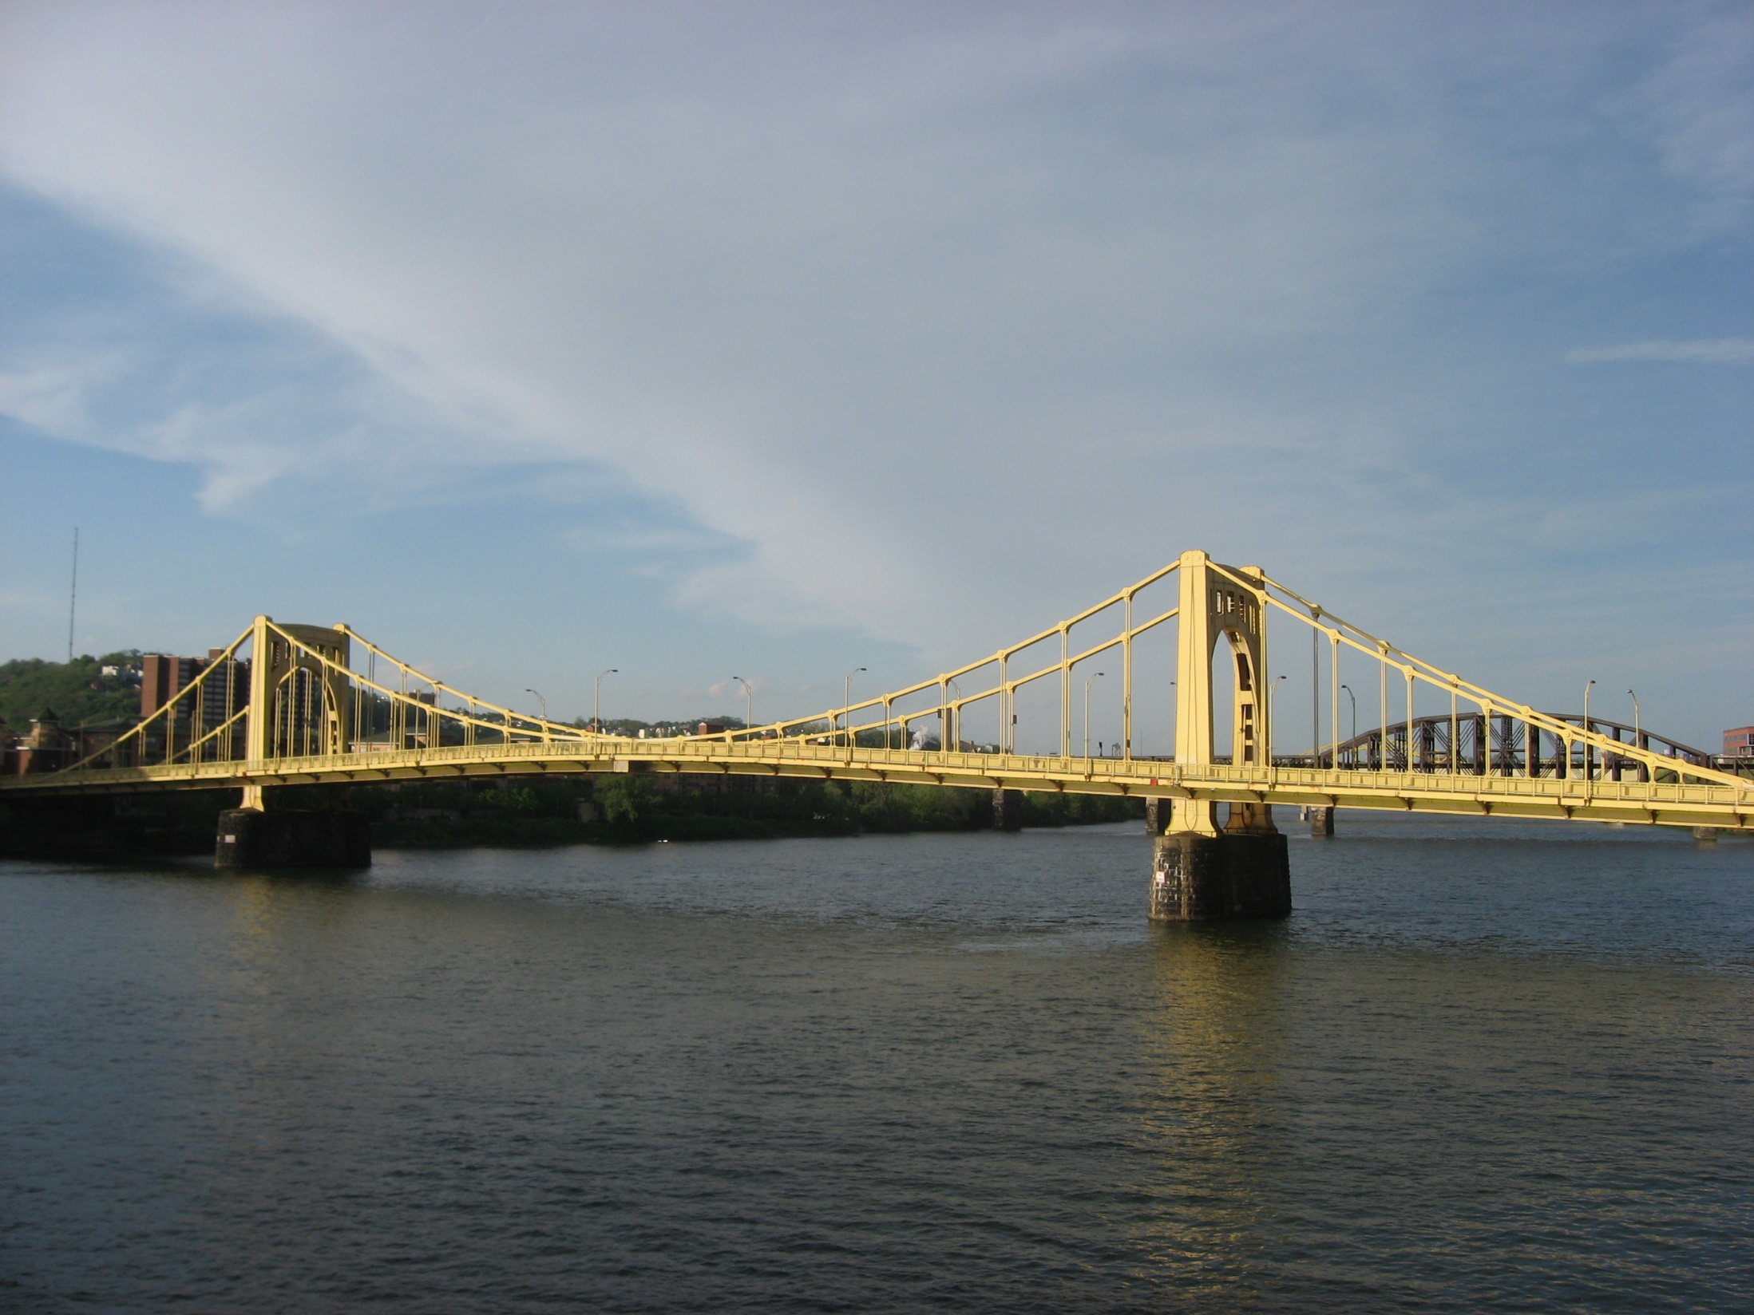
Notes:
On this image I had a bit of fun. I wanted to create a mirror effect. I took a copy of the bridge, and I turned it upside down. I distorted the one bridge so that it looked as if it was reflecting on the water. I used the stamp clone tool to make all of copied parts of the bridge have water instead of the sky. I added 3d text that to give my picture a title. Lastly, I added a filter to give the image a really neat and crisp effect.

Slide 9
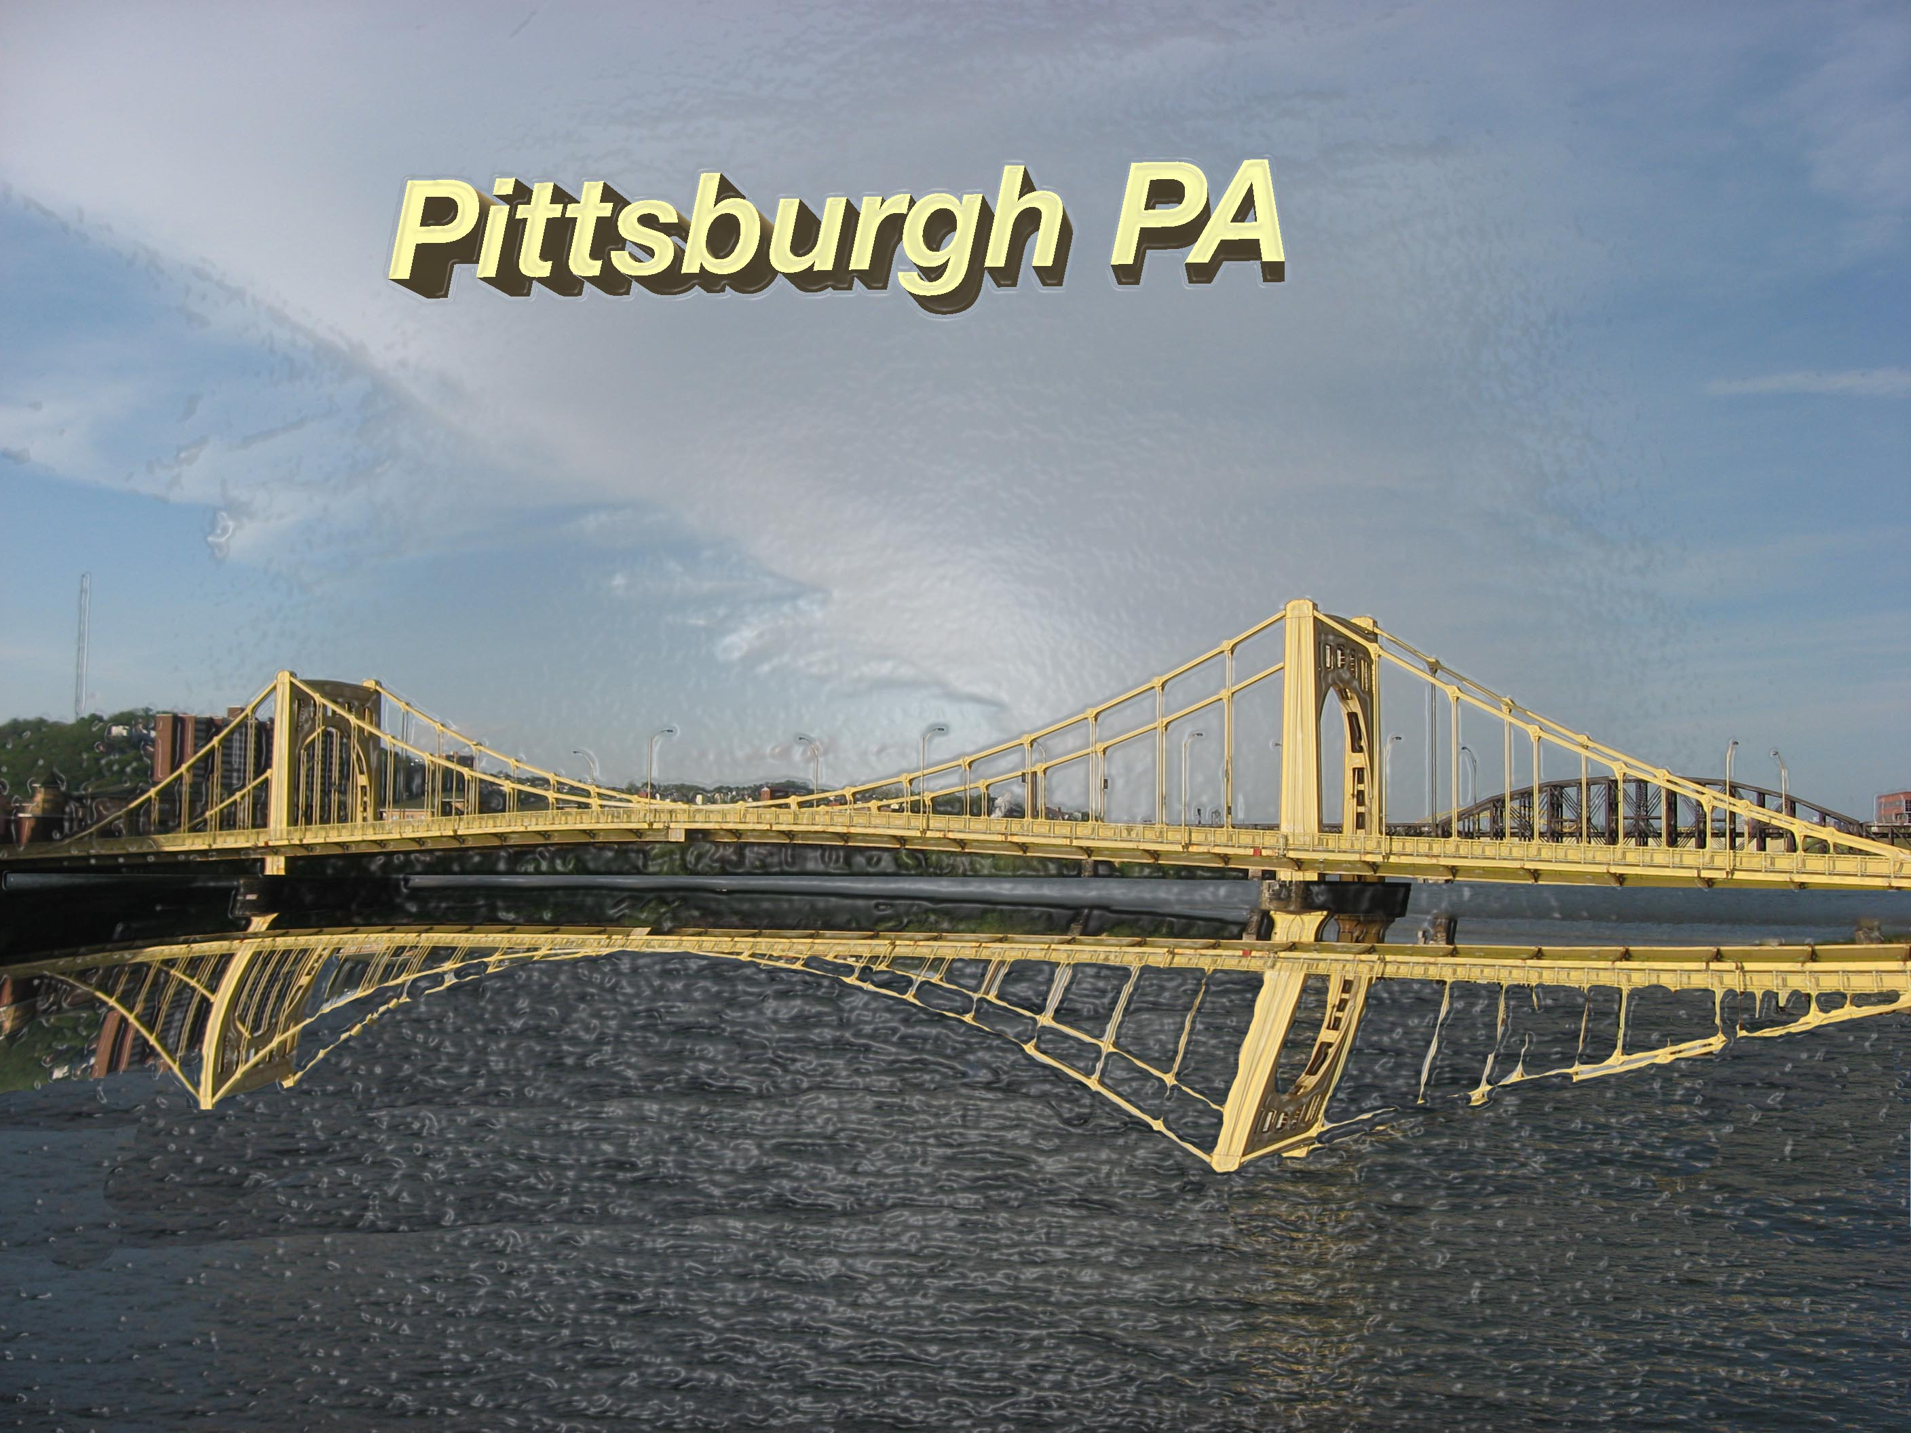

Slide 10
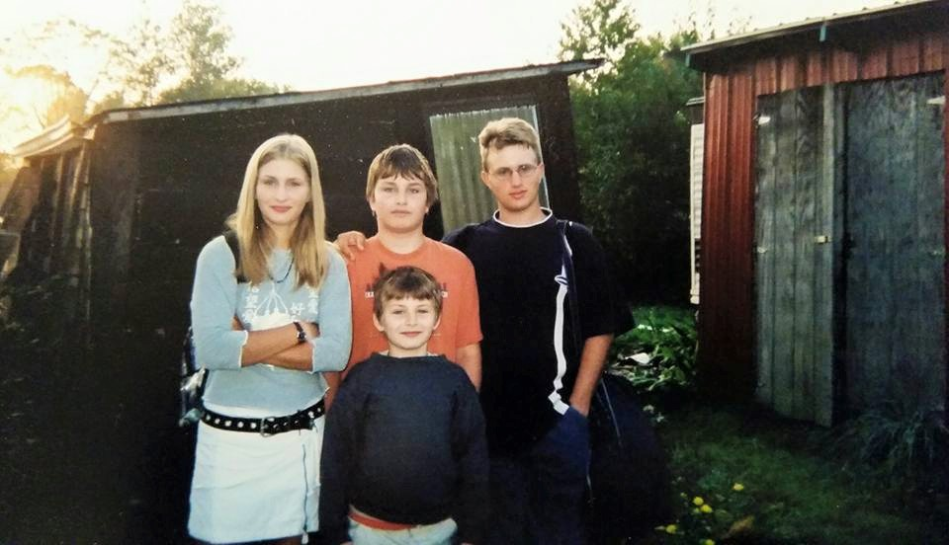
Notes:
In this image I changed the brightness and messed with the brightness. Also, I cropped the image so I didn’t see the unnecessary background. I cleaned up blemishes on the shed and my family. Lastly, I added a photo filter to block the sunglight on the left side.

Slide 11
